Slide 1
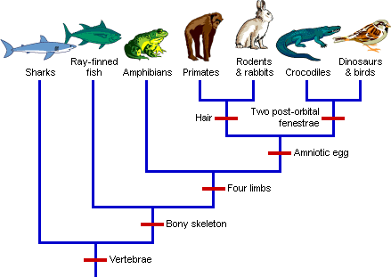

Evolutionary Trends
BIO 101 (part 1)
By
Alafia, A.O. (Ph.D)
DEPARTMENT OF ZOOLOGY AND ENVIRONMENTAL BIOLOGY

Slide 2
Evolutionary trend
EVOLUTIONARY TREND
Can be defined as a persistent, directional change in a character state, or set of character states, resulting in a significant change through time.
Evolution is gradual
Evolution means unrolling or unfolding. It is a process of gradual and orderly change from one condition to another. Such gradual and orderly changes are taking place in all the living, as well as non-living things.
EVOLUTION IS a scientific theory proposed by Charles Darwin. It occurs at the population level, It is made possible by genetic variations
Evolutionary trends can be determined by evaluating the amount of morphometric change per unit time.

Slide 3
Evolutionary trend
Evolutionary biology is a subfield of biology concerned with the study of the evolutionary processes that produced the diversity of life on Earth.
Evolutionary biologists study the descent of species, and the origin of new species.
EVIDENCES THAT SPECIES EVOLVE COMES FROM THREE LINES OF INVESTIGATION
Relationship were discerned among major groups of animals (Comparative anatomy)
Explorers discovered difference in the world distribution of species (Biogeography)
Geologist discovered apparent sequence of changing fossils in distinct layers of the earth

Slide 4
Types of Evolution
According to doctrine of organic evolution, the present living objects on the earth have descended from the early simpler organisms by the process of gradual modifications and changes.
Evolution may be progressive or retrogressive.
Progressive evolution means that simpler forms of organisms moves towards becoming more complex structural and physiological organizations.
Retrogressive evolution can also occur when structurally more complex organic forms produce simpler individuals e.g Echinoderms losing their heads.
Examples of retrogressive evolution in plants includes
Derivation of fungi from algal ancestors as a result of loss of chlorophyll,
The development of structurally simplified types of flowers from more elaborate and more complex flowers
Change from autotropic nature to parasitic mode of nutrition in parasitic Cuscuta due to loss of chlorophyll

Slide 5
The modern concept of organic evolution
The theory suggest that the living world has undergone vast modification in the remote past, it is changing and presumably it will go on changing in the future
The evolution in the past has resulted different types of organisms among which many have become extinct and many are still existing
Evolution yields new groups of plants and animals, advances very slowly and requires millions of years to produce new taxa
Evolution proceeds either on progressive or on retrogressive lines. Both these processes of evolution are proceeding simultaneously in nature

Slide 6
LEVELS OF EVOLUTION
There are two levels of evolution
Microevolution
Macroevolution
Microevolution- changes in allele frequencies in a population over generations, it occurs at the genetic level. Small scale changes.
What causes allele frequency to change
Natural selection
Genetic drift – chance events that alters allele frequencies
Gene flow – the transfer of alleles between populations.
Only natural selection can cause ADAPTIVE RADIATION,
Every species has features—adaptations—that are thought to enhance survival in its environment.

Slide 7
LEVELS OF EVOLUTION
Macroevolution-Larger changes, such as when a new species is formed. It includes the idea that all life forms is connected and can be traced back to one common ancestor.
Macroevolution is cumulative microevolution
The sweeping changes in life on Earth revealed by fossils illustrates MACROEVOLUTION

Slide 8
Levels of Evolution
The process of evolution can be summarized in three sentences:
Genes mutate.
Individuals are selected.
Populations evolve.
Note: individuals do not evolve but populations evolve e.g Biston betularia (English moth), Geospiza fortis.

Slide 9
Evolution
Evolution can be viewed in two related but different ways
As a pattern
As a process
One way to assess whether natural selection or other factors are causing evolution at a particular locus is to determine what the genetic makeup of a population would be if it were not evolving at that locus, and then compare with the real scenario. If there are no difference we can conclude that the real population is not evolving.

Slide 10
Thank you

